Slide 1
Economic Impact of a Data Product
21.10.2019
Ivana Trajanovska

Slide 2
History pre 1995
History Digital era
Increasing revenue with data science
The future of Data Science and AI
21.10.2019
Ivana Trajanovska

Slide 3
History pre 1995
21.10.2019
Ivana Trajanovska

Slide 4
History pre 1995
Winning Businesses
Companies use insights to improve customer experience
IBM
Nike
Chrysler
It’s all about product innovations

Slide 5
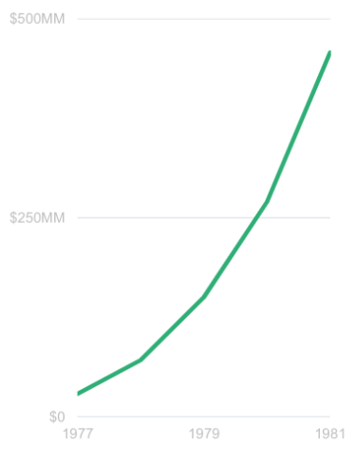
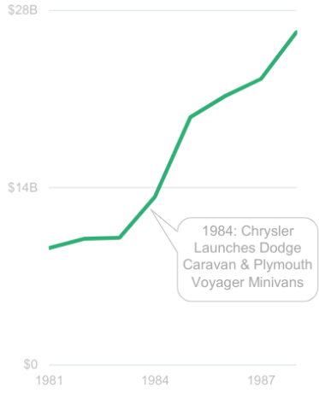
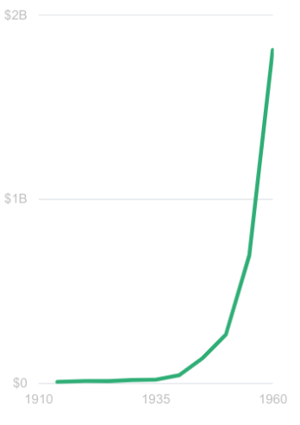
History pre 1995
IBM Nike Chrysler
Revenue
https://www.bondcap.com/report/

Slide 6
History digital era
21.10.2019
Ivana Trajanovska

Slide 7
History - Digital era
Winning Businesses
Capital One
Track customer shopping habits for marketing optimization
Amazon
Customer data to improve user experience and sales optimization

Slide 8
History - Digital era
New, important methods for building better products
Collect Data
Manage Connections
Optimize Data

Slide 9
History - Digital era
Collect data
Adidas - customer co-creation
Manage Connections
HelloFresh - feedback monitoring
Optimize Data
FarFetch - optimize order fulfillment

Slide 10
Data is now fundamental to how people work &
the most successful companies have intelligently
integrated it into everyone’s daily workflow
Data is the new application
Frank Bien - CEO and president, Looker 6/19

Slide 11
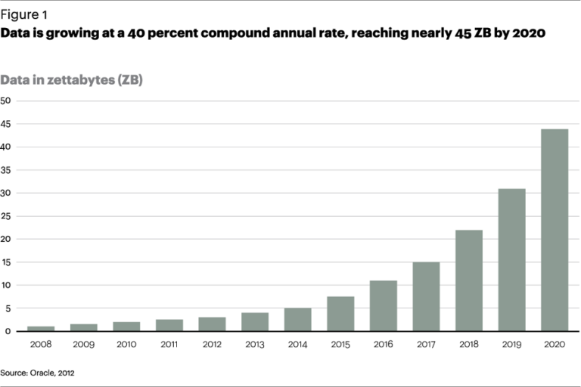
The rise of Big Data
https://htpartners.com/2016/03/01/the-rise-of-big-data-and-its-business-applications/

Slide 12
AI is the New Electricity
Andrew Ng

Slide 13
Vast usage of Data Science
Retail
Social Media
Streaming services
Accomodation
Energy Industry
Airlines
Medical domain

Slide 14
Increasing revenue with Data Science
21.10.2019
Ivana Trajanovska

Slide 15
Increasing revenue with Data Science
Laser-focused marketing campaigns
Track how campaigns are doing by market and by demographic within that market
Refine ads based on what works not what should work
70% of retargeted customers will convert
6% increase in profitability compared to companies reluctant to adopt data science

Slide 16
Increasing revenue with Data Science
Better email follow-through
80% from retail leaders think of newsletters as an most effective tool to retain customers
Customers that made purchase through newsletter link spend 38% more than other customers
Personalizing email subject lines increases the open rate by 5%
Only 23% use data science tools to track email activity

Slide 17
Increasing revenue with Data Science
Intelligent customer profiling
Knowing who the customer is and what they want is key to both marketing and customer service
Data science removes the potential of human bias to customers
Analyzing data on customers which brings revenue in different ways
Good at identifying customers with the highest potential lifetime

Slide 18
Increasing revenue with Data Science
Improving customer experience
86% of customers value a good buying experience over cost and will pay more for better service
Positive experience increases the likelihood of a new purchase by 15 times
Data science provides insights that allow for a personalized service on a large scale
Reminders around holidays
Retargeting customers at appropriate intervals (e.g. reminders for pet food)

Slide 19
Increasing revenue with Data Science
Price optimization
Goal - to find a profitable price that the customer is happy to pay so as to ensure repeat business.
Prices changed from static to customer specific
E.g. Airbnb tracks local events, hotel trends and location to recommend a price to the hosts
Some hotels customize their price based on a number of factors
E.g. Business or pleasure
How valuable is the customer as a client
What rates did the customer receive in the past

Slide 20
Increasing revenue with Data Science - Ford
2006 ended with $12.6 billion loss
Brought a data scientist that made a three-year overhaul
By 2009 they sold 2.3 million cars and made a profit by the end

Slide 21
Increasing revenue with Data Science - Airbnb
A group from Asia used their neighbourhood link to search neighbourhoods
A data scientist noticed it and proposed changing it with top traveling destinations in China, Korea, Japan and Singapore
It resulted with 10% more customers from that same group
Algorithm to optimize gaps between checkout and checkin based on host preferences
4% lift in booking conversion

Slide 22
Increasing revenue with Data Science - Energy industry
Adopting survival analysis concepts from the medical field
Used to predict the maintenance requirements for field equipment such as compressors
Proactive actions reduce downtime from 3 days to 1
Results in $60,000 revenue (at current prices)

Slide 23
Increasing revenue with Data Science - Airlines
Analyzing customers’ willingness to pay
Proactive reacting for parts maintenance reducing the 30% of flight delays
Fuel efficiency optimization
In flight sales and food supplies

Slide 24
The future of Data Science and AI

Slide 25
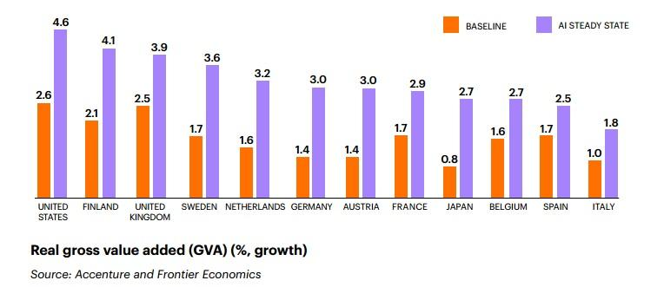
The future of Data Science and AI
https://seekingalpha.com/article/4063499-investing-artificial-intelligence-economic-growth-stock-picking

Slide 26
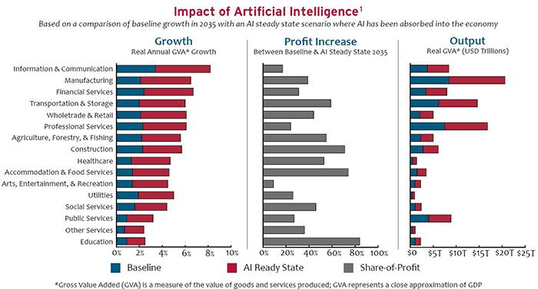
The future of Data Science and AI
http://www.northbridgeconsultants.com/blog/2017/09/19/the-artificial-intelligence-revolution-new-challenges-opportunities/

Slide 27
Resources
https://towardsdatascience.com/how-data-science-makes-money-for-businesses-203daba010c1
https://www.bondcap.com/report/
https://dataconomy.com/2014/11/5-ways-a-data-scientist-can-add-value-to-your-business/
https://conceptainc.com/blog/how-data-science-can-help-your-enterprise-generate-more-revenue/
https://neilpatel.com/blog/how-airbnb-uses-data-science/
https://www.cio.com/article/3052934/how-data-science-is-changing-the-energy-industry.html
https://dataconomy.com/2014/11/5-ways-a-data-scientist-can-add-value-to-your-business/

Slide 28
Thank you

